Slide 1

Predicting the Next Best NBA Shooters
Raeven Ruiz
9/14/2021

Slide 2
Goals of this Presentation
Understand what makes a “great” shooter in the NBA
Find the correlation between a player’s National Collegiate Athletics Association (NCAA) free-throw and three-point percentage with their NBA three-point percentage
Predict the most “NBA-ready” three-point shooters from the 2021 NBA Draft Class

Slide 3
What makes a great shooter?

Slide 4
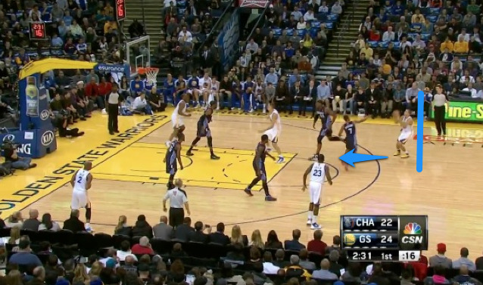
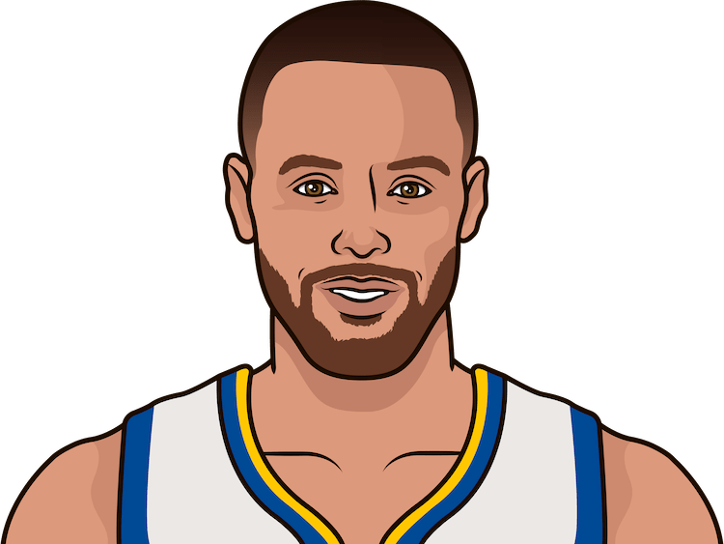
1.1 - What makes a great 3-point shooter?
Statistically…
Career average of 40.1% or higher (with 1000+ total attempts)
Top 20% of players in the past 25 years
Fundamentally…
Proper footing, bent knees, tucked elbows, straight torso prior to shot release
One motion all the way from gather to follow-through
Constient shot routine that never varies per shot
Stephen Curry has sunk 43.3 percent from beyond the arc in his career. - statmuse

Slide 5
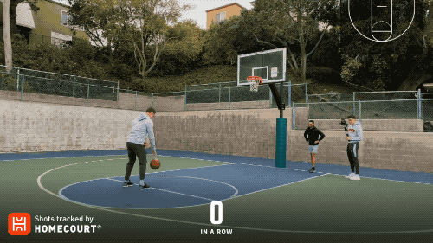

1.2 - What makes a great free-throw shooter?
Statistically…
Career average of 85.1% or higher (with 500+ total attempts)
Top 20% of players in the past 25 years
Fundamentally…
Proper footing, bent knees, tucked elbows straight torso prior to shot release
One motion all the way from gather to follow-through
Having the same routine every trip to the line
Steve Nash averaged 90.4 percent from the free-throw line in his career. - statmuse

Slide 6
Are they correlated?
Yes!

Slide 7
2.1 Both share the same shooting mechanics
Free-throws and three-point shooting both require the shooter to be squared to the basket and have proper balance prior to shooting, and also requires a good follow-through after releasing the ball
Repetition is key for consistent results

Slide 8
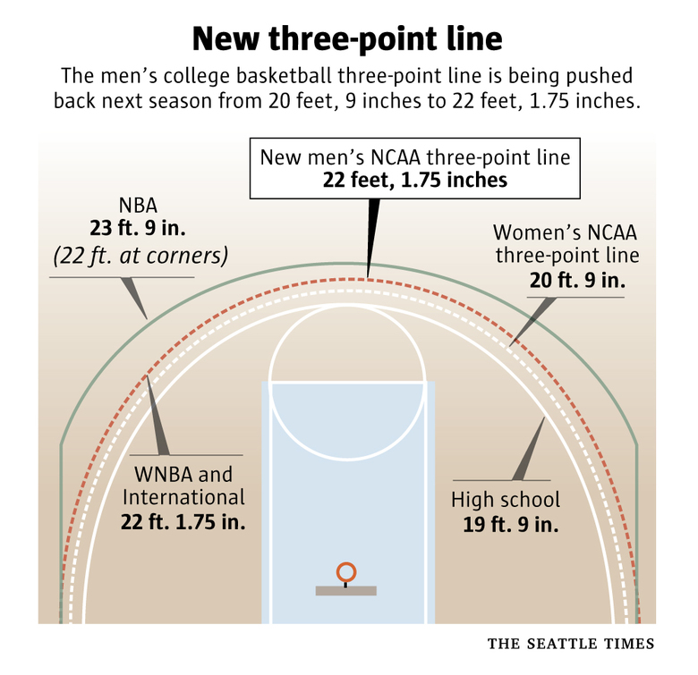
2.2 Three-point distance in the NBA is longer compared to the NCAA
23 feet, 9 inches (NBA) vs 22 feet, 1.75 inches (elsewhere)
This emphasizes the need of proper form, so players who have this discipline prior to the NBA can easily adjust to the further distance

Slide 9
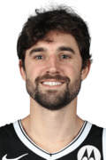
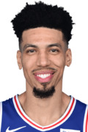
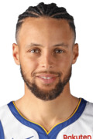

2.3 Which players will we be looking at?
Data will be based off of the 2018-2019 NBA Season.
To be in this dataset, players must meet the following criteria:
Played in at least half a season’s worth of games (41)
Averaged at least 2 three-pointers made per game
Played in the NCAA
Played in at least 20 games
Averaged at least 2.5 FTA and 2.5 FG3A
Resulted in a total of 23 players
Joe Harris
Danny Green
Player | FG3% (NBA) | FG3% (NCAA) | FT% (NCAA)
Joe Harris | 0.474 | 0.407 | 0.722
Danny Green | 0.455 | 0.375 | 0.845
Stephen Curry | 0.437 | 0.412 | 0.876
Buddy Hield | 0.427 | 0.390 | 0.836
Stephen Curry
Buddy Hield

Slide 10
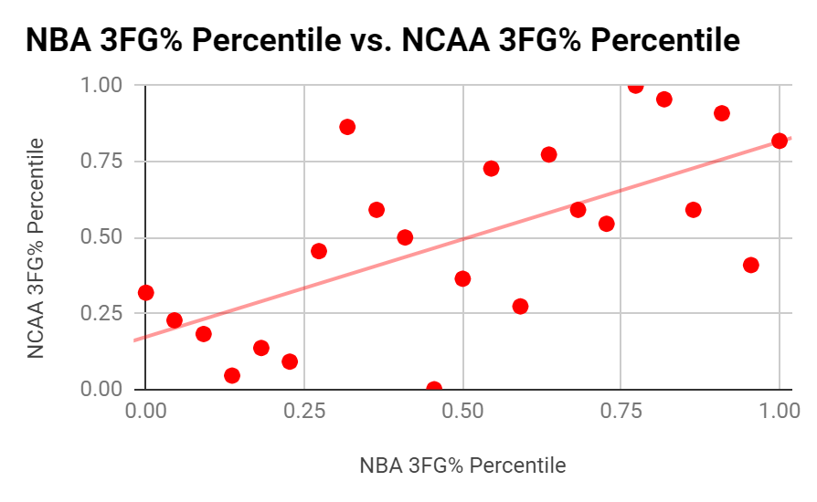
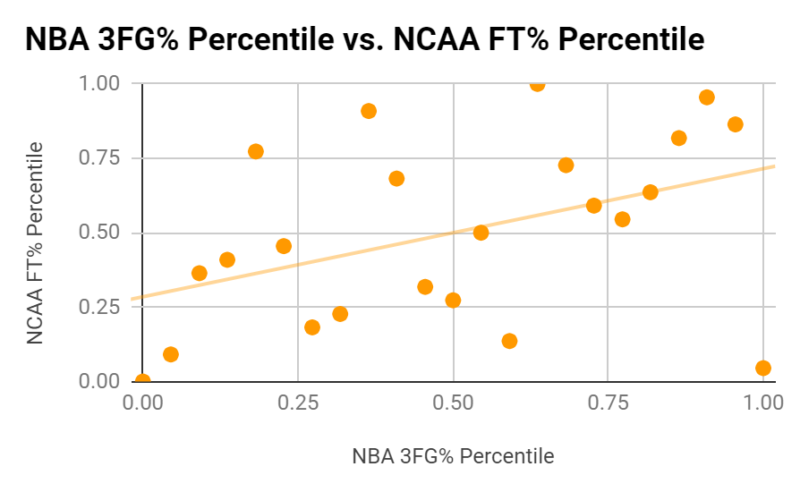
2.4 What does this correlation look like?
Correlation: 0.649
Correlation: 0.431

Slide 11
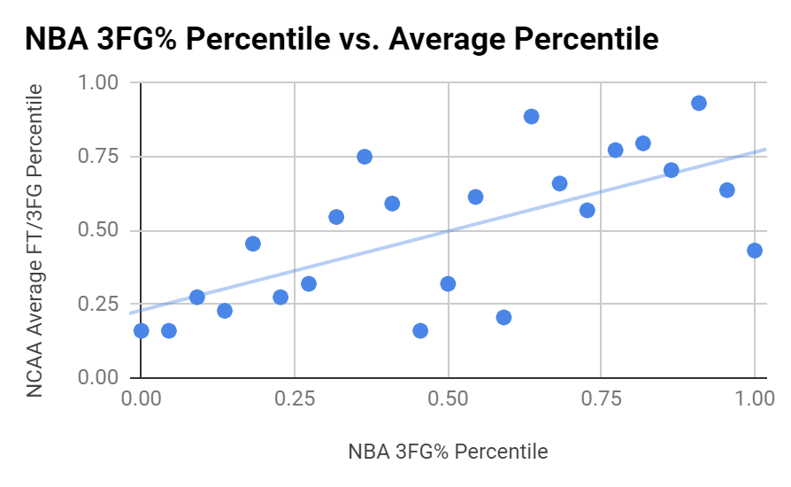
2.5 What does this correlation look like?
Correlation: 0.665

Slide 12
So, who’s going to be a great shooter in the NBA?

Slide 13
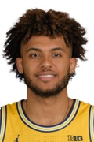
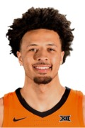
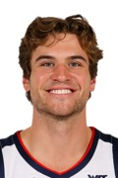
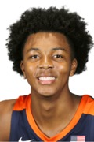
3.1 Exceptional Future 3-Point Shooters
Criteria for this group:
Free-throw percentage is 80% or above (on 1+ attempts)
Three-point percentage 40% or above (on 3+ attempts)
These prospects have proven to be the most consistent shooters prior to the draft and will prove to be great shooters in the NBA
Isaiah Livers
Cade Cunningham
Player | FT% | FTA | 3P% | 3PA
Isaiah Livers | 0.856 | 1.3 | 0.412 | 3.3
Cade Cunningham | 0.846 | 5.8 | 0.400 | 5.7
Corey Kispert | 0.824 | 1.8 | 0.408 | 4.8
Trey Murphy III | 0.819 | 1.9 | 0.401 | 5.5
Corey Kispert
Trey Murphy III

Slide 14
3.2 Potentially Great 3-Point Shooters
Criteria for this group:
Free-throw percentage is 80% or above (on 2+ attempts)
Three-point percentage 30% or above (on 3+ attempts)
Not in the group prior
These prospects may not be as exceptional as the group prior, but they do show proper shooting fundamentals that can translate to them being decent to great shooters in the NBA
Player | FT% | FTA | 3P% | 3PA
Cameron Thomas | 0.882 | 7.6 | 0.325 | 7.2
Franz Wagner | 0.835 | 2.4 | 0.325 | 4.3
Jalen Green | 0.829 | 2.3 | 0.365 | 5.7
Bones Hyland | 0.827 | 2.4 | 0.325 | 4.3
Player | FT% | FTA | 3P% | 3PA
Moses Moody | 0.812 | 5.8 | 0.358 | 5.1
Chris Duarte | 0.803 | 2.9 | 0.380 | 5.3
James Bouknight | 0.802 | 4.2 | 0.32 | 3.4
Josh Christopher | 0.800 | 3.7 | 0.305 | 3.9

Slide 15
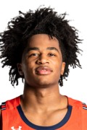
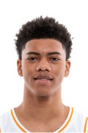
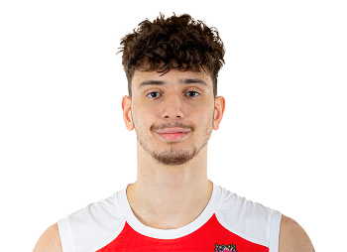
3.3 Dark Horse 3-Point Shooters
Criteria for this group:
Free-throw percentage is 80% or above (on 4+ attempts)
Not in any prior group
Although they may not have the 3P% to prove it just yet, these prospects have great free throw shooting fundamentals than can translate to them being great 3-point shooters. All they need is the proper coaching and development.
Sharife Cooper
Jaden Springer
Player | FT% | FTA | 3P% | 3PA
Sharife Cooper | 0.825 | 8.6 | 0.228 | 4.8
Alperen Sengun | 0.812 | 6.2 | 0.190 | 0.7
Jaden Springer | 0.810 | 4.0 | 0.435 | 1.8
Alperen Sengun

Slide 16
4.1 Conclusion
Why is it important to look at free-throw percentage in regards to a player’s potential three-point performance?
Both FTs and 3PTs share similar body mechanics
Good free-throw routines and performances demonstrate a player understands proper shooting fundamentals that could be easily applied to three-point shooting as well
Why is it important to draft a good shooter?
The league has been moving from traditional big men-centered teams
The rise of analytics has caused teams to prioritize 3-point shooting in terms of forming teams

Slide 17
Thank You!
Questions / Comments?
Email: raeven.ruiz98@gmail.com
Github: https://github.com/raevenruiz/predict-nba-shooters

Slide 18
References
Project inspiration came from:
Fact or Fiction: Is College Free Throw Percentage Better Than College Three Point Percentage at Predicting Three Point Shooting Success In The NBA?
Player data obtained from:
NBA SQL v0.0.4
basketball-reference.com
sports-reference.com/cbb
statmuse.com

